Slide 1



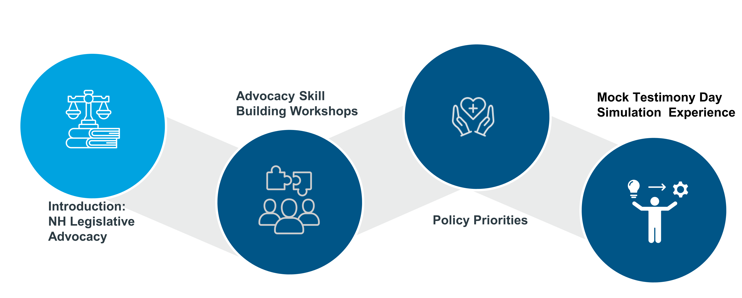






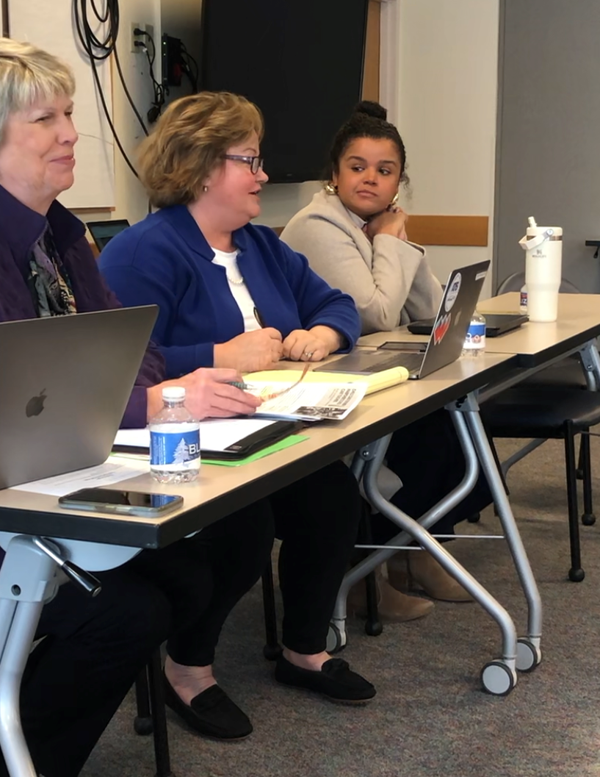
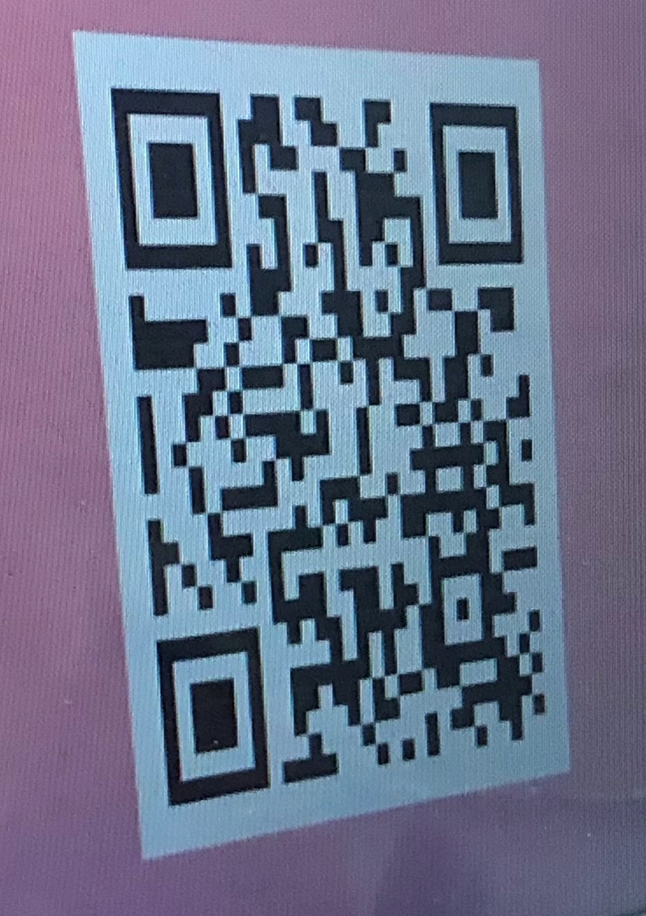






Voices for Change: NH Legislative Advocacy
Kathy Stocker, Ava Hawkes, Sue Tanski, M.D., Steven Chapman, M.D.
,
ff
https://owa.hitchcock.org/OWA/service.svc/s/GetFileAttachment?id=AAMkADMyYTBmZDBmLTBjYzYtNDFkYy1hM2IzLWNhODljMjcwMTlhMQBGAAAAAACJ7fNh3tUySZzN6ksyCTz+BwD1WOP/dsuwS5kACpOsFXKMAAAAAAEMAAD1WOP/dsuwS5kACpOsFXKMAAEMTYe7AAABEgAQAHGhIq4nyCRAtsIkERHZgzM=&X-OWA-CANARY=Bg_dhfBQTEK4cn8PycmYK9BHDS13ttwIJ2TR-H4iFS09Ff50kU_kfUwxDnTtYqqn5IvN87m5OkA.&isImagePreview=True
LEGISLATIVE ADVOCACY GOALS
2024 KEY ISSUES/ BILLS
NH PEDIATRIC LEGISLATIVE ADVOCACY ROADMAP
SB 404 –Relative to expanding child care professionals’ eligibility for the child care scholarship program.
Provides child care workers with access to the New Hampshire Child Care Scholarship program as a proactive approach to addressing the statewide child care workforce shortage.
Update SB 404 - August 2, the Governor signed into law!
SB 499 – Relative to the supplemental Nutrition Assistance Program and summer EBT.
Summer EBT program to support families with children eligible for free and reduced price meals, and provision of disaster relief funding and SNAP elderly simplified application project.
Update SB 499 signed into Law on August 2, 2024
SB 559 Relative to the NH vaccine Association
This bill defines biological projects for purposes of the assessment determination by the NH vaccine association. This bill ensures access to the RSV immunization for NH children.
Update SB 559 signed into law by the Governor on July 26.
Develop understanding of policy impact on child health
Familiarize with legislative processes and protocols
Enhance skills in crafting persuasive arguments
Practice delivering clear, concise and impactful testimony
Foster collaboration with advocacy organizations
Be A trusted voice on child policy
PARTNERSHIPS
DH Government Relations
Observation of actual hearings and processes
Testifying on bills related to pediatric health
Meeting with legislators and the governor
Debriefing sessions to discuss experience
2024 NH PEDIATRIC ADVOCACY DAY
Observation of actual hearings, processes and Press Conference on LGBTQ+ Bills
Strategic Prep for Meetings
Senator Carson, Senator Prentiss
Governor Sununu
House Health and Human Services Chair Wayne MacDonald
House Minority Leadership Representative Alexis Simpson
Testifying on bills related to pediatric health
Debriefing sessions to discuss experience
HOW TO GET INVOLVED
Residents, Faculty and DH Staff
at the State House for
2024 NH Pediatric Legislative Advocacy day
2024 Mock testimony panel- former Senator, Polly Campton, Senator Sue Prentis and Ava Hawkes, Medical Society
Contact Steve Chapman, MD
Steven.H.Chapman@hitchcock.org
Engage with Legislators
Listen to families and children
Sign up for New Futures Action Alerts
Register to Vote
“Pediatricians see the human face of inequity and systems that just don’t work. By sharing these stories and data with legislators we become powerful agents for change” - Steve Chapman, MD
Notes:
Two quotes from participants.
I loved it. Well organized. Impactful. I learned a lot and do feel more empowered to engage and be an advocate after the training day. Thank you!
really appreciated the well-planned out schedule for the entire day, which was very engaging! Meeting all the representatives was super interesting!

Slide 2
Voices for Change: NH Legislative Advocacy
Kathy Stocker, Ava Hawkes, Sue Tanski, M.D., Steven Chapman, M.D.
,
ff
https://owa.hitchcock.org/OWA/service.svc/s/GetFileAttachment?id=AAMkADMyYTBmZDBmLTBjYzYtNDFkYy1hM2IzLWNhODljMjcwMTlhMQBGAAAAAACJ7fNh3tUySZzN6ksyCTz+BwD1WOP/dsuwS5kACpOsFXKMAAAAAAEMAAD1WOP/dsuwS5kACpOsFXKMAAEMTYe7AAABEgAQAHGhIq4nyCRAtsIkERHZgzM=&X-OWA-CANARY=Bg_dhfBQTEK4cn8PycmYK9BHDS13ttwIJ2TR-H4iFS09Ff50kU_kfUwxDnTtYqqn5IvN87m5OkA.&isImagePreview=True
LEGISLATIVE ADVOCACY GOALS
2024 KEY ISSUES/ BILLS
NH PEDIATRIC LEGISLATIVE ADVOCACY ROADMAP
SB 404 –Relative to expanding child care professionals’ eligibility for the child care scholarship program.
Provides child care workers with access to the New Hampshire Child Care Scholarship program as a proactive approach to addressing the statewide child care workforce shortage.
Update SB 404 - August 2, the Governor signed into law!
SB 499 – Relative to the supplemental Nutrition Assistance Program and summer EBT.
Summer EBT program to support families with children eligible for free and reduced price meals, and provision of disaster relief funding and SNAP elderly simplified application project.
Update SB 499 signed into Law on August 2, 2024
SB 559 Relative to the NH vaccine Association
This bill defines biological projects for purposes of the assessment determination by the NH vaccine association. This bill ensures access to the RSV immunization for NH children.
Update SB 559 signed into law by the Governor on July 26.
Develop understanding of policy impact on child health
Familiarize with legislative processes and protocols
Enhance skills in crafting persuasive arguments
Practice delivering clear, concise and impactful testimony
Foster collaboration with advocacy organizations
Be A trusted voice on child policy
PARTNERSHIPS
DH Government Relations
Observation of actual hearings and processes
Testifying on bills related to pediatric health
Meeting with legislators and the governor
Debriefing sessions to discuss experience
2024 NH PEDIATRIC ADVOCACY DAY
Observation of actual hearings, processes and Press Conference on LGBTQ+ Bills
Strategic Prep for Meetings
Senator Carson, Senator Prentiss
Governor Sununu
House Health and Human Services Chair Wayne MacDonald
House Minority Leadership Representative Alexis Simpson
Testifying on bills related to pediatric health
Debriefing sessions to discuss experience
HOW TO GET INVOLVED
Residents, Faculty and DH Staff
at the State House for
2024 NH Pediatric Legislative Advocacy day
2024 Mock testimony panel- former Senator, Polly Campton, Senator Sue Prentis and Ava Hawkes, Medical Society
Contact Steve Chapman, MD
Steven.H.Chapman@hitchcock.org
Engage with Legislators
Listen to families and children
Sign up for New Futures Action Alerts
Register to Vote
“Pediatricians see the human face of inequity and systems that just don’t work. By sharing these stories and data with legislators we become powerful agents for change” - Steve Chapman, MD
Notes:
Two quotes from participants.
I loved it. Well organized. Impactful. I learned a lot and do feel more empowered to engage and be an advocate after the training day. Thank you!
really appreciated the well-planned out schedule for the entire day, which was very engaging! Meeting all the representatives was super interesting!

